Slide 1
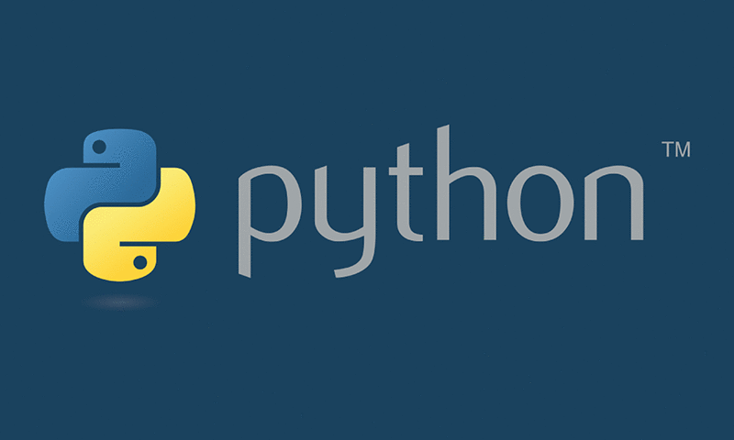
Prepared By
N. Sreevidya
Assistant Professor
Dept. of IT

Slide 2
Sreenidhi Institute of Science and Technology
Department of IT
B. Tech II Year II Semester – A22 Regulation
Python Programming
Code: 9FC02
Prerequisite: Problem Solving using C Lab
Course Objectives:-
Use Python interactively, execute a Python script at the shell prompt, use Python types, expressions, and None, use string literals and string type, use Python statements (if...elif..else, for, pass, continue, . . . ), understand the difference between expressions and statements, understand assignment semantics, write and call a simple function., utilize high-level data types such as lists and dictionaries, understand the difference between mutable and immutable types, write a simple class and access methods and attributes, import and utilize a module, read from and write to a text file.
Course Outcomes: After taking this course, you should be able to:
1. Gains exposure towards Python versions and their specifications.
2. Build programs using primitive data types.
3. Write applications that include functions, modules, and packages along with respective exceptional handling
mechanism.
4. Writes applications using OO features of Python
5. Write applications using Files.
6. Experience Hands on exposure on NumPy/Tkinter/Plotpy modules.

Slide 3
Syllabus
Unit I : Introduction to Python:History, Features, Modes of Execution, Setting up path, working with Python Basic Syntax, Variable and Data Types, Operators. Conditional Statements (If, If- else, Nested if-else) Looping (for, While Nested loops) Control Statements (Break, Continue, Pass). Input-Output: Printing on screen, Reading data from keyboard, Opening and closing file Unit II : Functions: Defining a function, calling a function, Types of functions, Function Arguments, Anonymous functions, Global and local variables String Manipulation: Accessing Strings, Basic Operations, String slices, Function and Methods Lists: Accessing list, Operations, Working with lists Function and Methods Tuple: Accessing tuples, Operations, Working. Dictionaries: Accessing values in dictionaries, working with dictionaries, Properties Functions and Methods. Unit III: Modules: Importing module, Math module, Random module, Packages Exception Handling: Exception, Exception Handling, Except clause, Try? Finally clause User Defined Exceptions Unit IV : Python- OOPs concept: Class and object, Attributes, Inheritance, Overloading Overriding, Data hiding. Regular expressions: Match function, Search function, Matching VS Searching, Modifiers Patterns Unit V : Introduction to Files, File Handling, Working with File Structure, Directories, Handling Directories Unit VI :Case Study with NumPy/PlotPy/SciPy/GUI Programming, Introduction, Tkinter programming, Tkinter widgets

Slide 4
Text books:
[Apress]-Beginning Python. From Novice to Professional, 2nd ed. - [Hetland] (2008)
Reference books:
1. Introduction to Computation and Programming using Python, Revised and Expanded Edition, John V. Guttag, The MIT Press.
2. Programming Python, Fourth Edition by Mark Lutz, O'Relly
3. Python Programming using problem solving approach, Reema Thareja, Oxford Higher Education.

Slide 5
UNIT – I
Contents:
Introduction to Python
History
Features
Setting up path
Working with Python Basic Syntax
Variable and Data Types
Operators
Conditional Statements(If ,If- else ,Nested if-else)
Looping( for, While Nested loops)
Control Statements(Break , Continue ,Pass)
Input-Output: Printing on screen, Reading data from keyboard, Opening and closing file

Slide 6
Introduction to Python
Python is a high-level, interpreted, interactive and object-oriented scripting language. It is designed to be highly readable.
Python is Interpreted: Python is processed at runtime by the interpreter. You do not need to compile your program before executing it .
Python is Interactive: You can actually sit at a Python prompt and interact with the interpreter directly to write your programs.
Python is Object-Oriented: Python supports Object-Oriented style or technique of programming that encapsulates code within objects.
Python is a Beginner's Language: Python is a great language for the beginner-level programmers and supports the development of a wide range of applications from simple text processing to WWW browsers to games.

Slide 7

History of Python
Python was developed by Guido Van Rossam in 1989 while working with NRI at nether land but officially Python language was available to the public on Feb20th1991.
Guido Van Rossam

Slide 8
Why the name “Python”?
While implementing Python, Guido van Rossum was also reading the published scripts from "Monty Python's Flying Circus" (a BBC comedy series from the seventies
Why Python?
Python works on different platforms (Windows, Mac, Linux, Raspberry Pi, etc).
Python has a simple syntax similar to the English language and has syntax that allows developers to write programs with fewer lines than some other programming languages.
Python relies on indentation, using whitespace, to define scope; such as the scope of loops, functions and classes.
Python runs on an interpreter system, meaning that code can be executed as soon as it is written. This means that prototyping can be very quick.
Python can be treated in a procedural way, an object-oriented way or a functional way.

Slide 9
Python is derived from many other languages
Python syntax borrowed from C and ABC language
Functional programming from C language
OOP Features from C++
Scripting languages features from Perl and shell
Modular programming features from modula3.
  Major implementations of Python are :
Cpython, Jython, IronPython, Brython, RubyPython, PyPy, Beautiful Soup etc..

Slide 10
Python versions
There are three main versions of Python
Python 1.0 introduced in jan 1994
Python 2.0 introduced in oct 2000
Python 3.0 introduced in Dec 2008
Latest version of python:
Python 3.7.3 introduced in March 25,2019
Python 3.11 introduced on October 24, 2022(python 3.12 is stable version)
Note:
Any new version should provide support for old version programs. In python there is no such type of backward compatibility.
If I am using python 3, it’s never going to support for python 2.
print "hello" valid in python2 but invalid in python3.
Long data type is there on python2 but not in python3

Slide 11
Features of Python :
Simple and easy to learn
Freeware and open source
High level programming language
Platform independent
Portability
Dynamically typed
Both procedure oriented and Object Oriented
Interpreted
Extensible
Embedded
Extensive Library

Slide 12
1. Simple and easy to learn:
Python is a very easiest programming language. Any non-technical personal can understand code that much easy to learn Python.
2. Freeware and open source
For developing a Python application you do not need to take a license. Freeware means we do not require to pay single rupees.
Open source means we can see the code (implementation) of Python and also we are allowed to make changes in the code and create one new version (own version) of Python.
3. Platform independent
Python provides WORA(write once and read anywhere) feature. You can write application on one platform and run anytime on any machine.
Example:- write a program on windows and run code in Linux or any platform.
4. Portability
Portability means moving Python program from one platform to another without making any changes.
Example:- If you developed the application on windows machine and windows encounters a problem then you can move to Linux machine is easy.

Slide 13
5. High-level programming language
We write code as normal English statement and we don’t require to worry about low-level management.
6. Interpreted
In Python we don’t need to compile the Python code, Python interpreter will compile the code if compilation fails Python raises a compilation error. Once compilation is successful, Python virtual machine executes the code. The interpreter executes the code line by line.
7. Embedded
We can use python in other languages. Python program can be embedded in other languages also.
8. Rich library support
In python, there is a large number of the library available for every requirement. We don’t require to write large code we simply import libraries and use it in our code.

Slide 14
Python unique features
1. Extensible:
In Python, we can use other language programs (example: c, java)
2. Dynamically typed language
It is the most important feature of Python. In Python, we are not required to specify the type of variable. We simply write the variable name and assign value.
Python automatically assigns the type of variable depending on value.
Example:- x=10 Python variable without a type
Based on the type of value Python assigns ‘int’ type to x variable.
3. Both procedure oriented and object-oriented language:
If you go for Python you can use both procedural and object-oriented features. Python also supports scripting language features.

Slide 15
Applications of python:
Desktop application
Web applications : Django, Pyramid, Flask..etc
Data base applications
For Networking applications
Games
Data Analysis
Machine Learning applications
AI application
For IOT applications
Animation Applications
Note: for mobile based applications, not that much recommended.

Slide 16
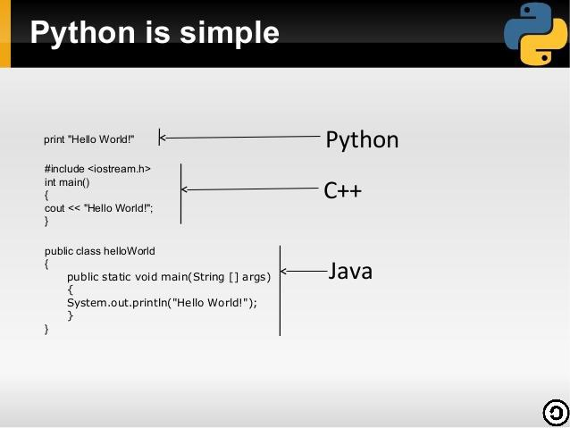


Slide 17
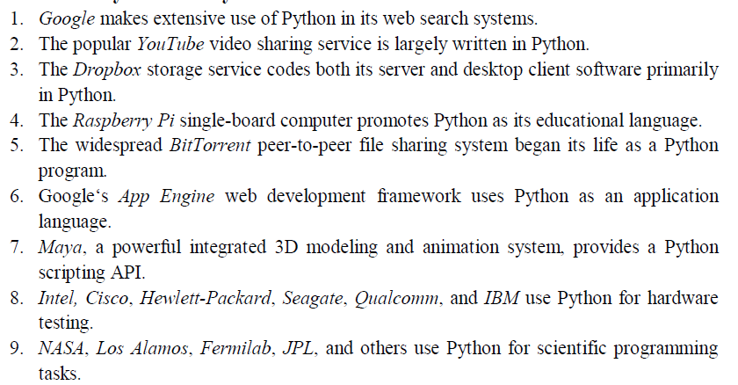
Which companies are using python?

Slide 18


Slide 19
Limitations of python:
Performance and Speed
Incompatibility of Two Versions
Mobile applications

Slide 20
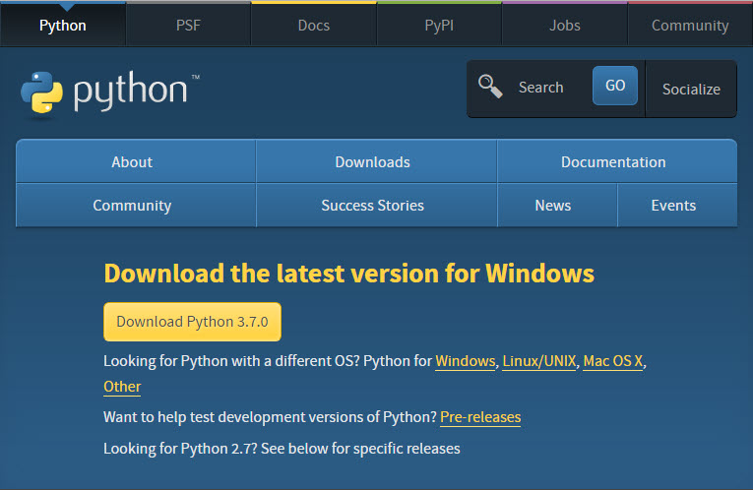
Installation of python
To install Python on a Windows machine, follow these steps:
Open a web browser and go to http://www.python.org , its free
Click the Download. The following page will appear in your browser.

Slide 21

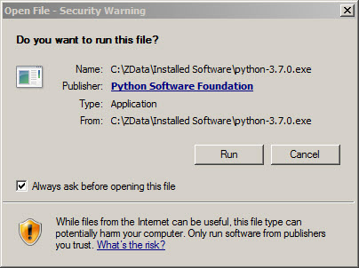
3. Click the Download Python 3.7.0 button.
4. The file named python-3.7.0.exe should start downloading into your standard download folder.
5. The file should appear as
6. Double-click the icon labelling the file python-3.7.0.exe.
7. An Open File - Security Warning pop-up window will appear.
8. Click Run.

Slide 22
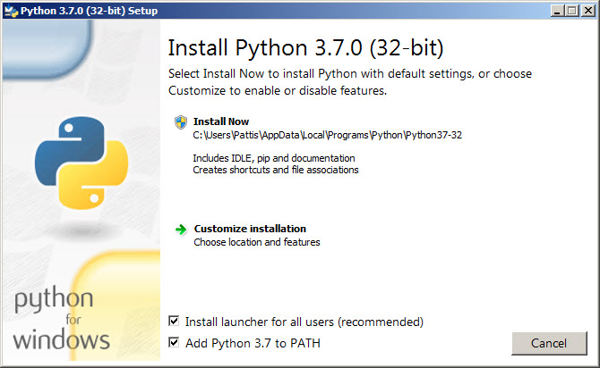
9. A Python 3.7.0 (32-bit) Setup pop-up window will appear.
10. Ensure that the Install launcher for all users (recommended) and the Add Python 3.7 to PATH checkboxes at the bottom are checked.
11.If the Python Installer finds an earlier version of Python installed on your computer, the Install Now message may instead appear as Upgrade Now

Slide 23
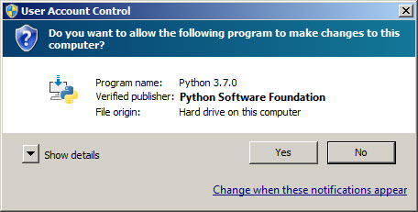
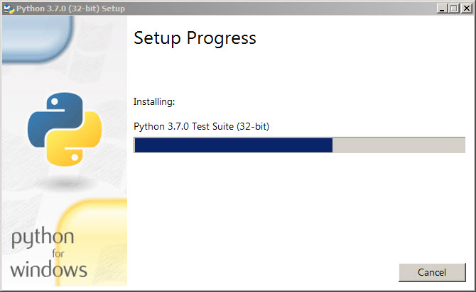
12. Click the Yes button.
13. A new Python 3.7.0 (32-bit) Setup pop-up window will appear with a Setup Progress message and a progress bar.

Slide 24
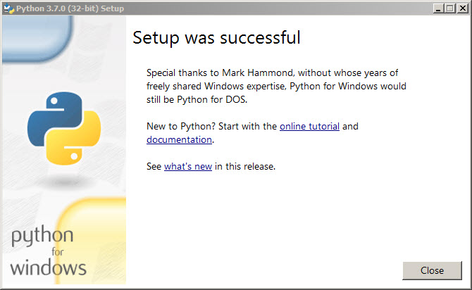
14. During installation, it will show the various components it is installing and move the progress bar towards completion. Soon, a new Python 3.7.0 (32-bit) Setup pop-up window will appear with a Setup was successfully message.
15. Click the Close button.
Python should now be installed.

Slide 25
Setting up path in python
To add the path to the python.exe file to the Path variable, start the Run box and enter sysdm.cpl
Go to the Advanced tab and click the Environment Variables button.
In the System variable window, find the Path variable and click Edit.
Position your cursor at the end of the Variable value line and add the path to the python.exe file, preceded with the semicolon character (;). In our example, we have added the following value: ; C:\python 35-32;
Close all windows. Now you can run python.exe without specifying the full path to the file:

Slide 26
Working with Python Basic Syntax
There are two ways to use the Python interpreter:
1. Interactive Mode / shell mode (line by line execution):
In shell mode, you type Python expressions into the Python shell, and the interpreter immediately shows the result.
>>> 2 + 3
5
>>> is called the Python prompt.
2. Batch Mode (entire program execution at a time):
The concept of writing group of python statements into a file, saving that file with the extension ‘.py’ and submitting the entire file to the python interpreter at a time is known as Batch mode.
To run a python program from command line
C:\Users\Your Name>python helloworld.py
Note :
Type python or py in command prompt and you can use python from there as a shell interpreter
To quit from command line python, type exit()

Slide 27
In order to develop the python files we use either editors or IDE’s.
Different editors are notepad, notepad++, edit plus, vi, nano, gedit----
Different IDE’s are pycharm, eric, netbeans, eclipse
Open the notepad and write the following statements.
X=100
Y=20
Print(x+y)
Print(x-y)
Print(x*y)
Print(x/y)
Save the above file with demo.py in D:\foldername
Open the command prompt and execute the following commands.
D:\foldername >python demo.py
120
80
2000
5.0

Slide 28
Keywords in Python
Keywords are the reserved words in Python.
We can not use a keyword as variable name, function name or any other identifier.
They are used to define the syntax and structure of the Python language.
keywords are case sensitive.
There are 35 keywords in Python.
All the keywords except True, False and None are in lower case and they must be written as it is.
You can always get the list of keywords in your current version by typing the following in the prompt.
>>> import keyword
>>> keyword.kwlist (or)
>>>help()
help>keywords

Slide 29
The list of all the keywords are given below:
Keywords in Python
True | False | None
and | or | not | is
if | else | elif
while | for | break | continue | return | in | yield
try | except | finally | raise | assert | await
import | from | as | class | def | pass | global
nonlocal | lambda | del | with | async
Note : cls can be used to clear the screen in python command prompt window

Slide 30
Python Indentation
Indentation refers to the spaces at the beginning of a code line.
The indentation in Python is very important, it can be 1 or 2 or 3 or 4 spaces. 4 spaces is common, it has to be at least 1 space.
Python uses indentation to indicate a block of code.
Example of Syntax Error:
if 5 > 2:
print("Five is greater than two!")
If 5 > 2:
print("Five is greater than two!") is correct
Comments
Python Comments start with a #
Example
#This is python code----→is a comment
print(“Comments”)

Slide 31
Multiline Comments
To add a multiline comment you could insert a # for each line or add a multiline string “”” and “””
        #This is a comment
        #written in
        #more than just one line
        print("Hello, World!")
or
        """
        This is a comment
        written in
        more than just one line
        """
        print("Hello, World!")

Slide 32
Python Identifiers :
The name which can be used for identification purpose is known as Identifiers.
Identifier definition:- Name in python program is Identifiers. It may be variable name, method name or class name.
Identifiers Example
x=10 => variable name
class A{ } => Class name A
disp(){ } => Function name disp()
valid identifier in Python:
Identifiers can be a combination of letters in lowercase (a to z) or uppercase (A to Z) or digits (0 to 9) or an underscore (_).

Slide 33
Rules for Identifiers:
Identifier should contain Alphabet symbols (Upper or lower case), digits ( 0 to 9), Underscore.
Example :- Cast = 10 => valid
Ca$h=10 => Invalid
Identifiers should not start with digits.
Example :- total123 = 10 => valid
123total=10 => Invalid
Python is case sensitive language.
Example :- total=10
TOTAL=10
Both variables are different
We cannot use keywords as Identifiers.
Example :- x=10 => Valid
def=20 => Invalid
if=15 => Invalid

Slide 34
5. Maximum allowed length in Identifiers :-
There is no length limit for python identifier. You can use any number of characters.
Example :- abccccccccccc=10
6. Identifiers starts with _(underscore) then it is private.
7. Identifiers starts with __ ( double underscore ) then it is strongly private.
8. We write Language specific identifiers as __Identifier__ (starts and ends with double underscore)
Getting the data type
You can get the data type of a variable with the type() function.
Example
x = 5
y = "John"
print(type(x))
print(type(y))

Slide 35
String variables can be declared either by using single or double quotes
Example: x=“hello” is similar to x=‘hello’
Python Statement:
Instructions that a Python interpreter can execute are called statements.
For example, a = 1 is an assignment statement.
Multi-line statement:
In Python, end of a statement is marked by a newline character. But we can make a statement extend over multiple lines with the line continuation character (\).
For example:
a = 1 + 2 + 3 + \
4 + 5 + 6 + \
7 + 8 + 9

Slide 36
Python Comments:
Comments are very important while writing a program.
It describes what's going on inside a program so that a person looking at the source code does not have a hard time figuring it out.
# symbol to start writing a comment.
It extends up to the new line character.
Comments are for programmers for better understanding of a program. Python Interpreter ignores comment.
Example:
#This is a single line comment
#print out Hello
print('Hello')
Multi-line comments
If we have comments that extend multiple lines, We can use triple quotes, either '''or """. These triple quotes are generally used for multi-line strings. But they can be used as multi-line comment as well.
Example
"""This is also a
Perfect example of
multi-line comments"""

Slide 37
Escape Characters:
An escape character is a special character that is preceded with a backslash (\), appearing inside a string literal.
When a string literal that contains escape characters is printed, the escape characters are treated as special commands that are embedded in the string.
Some of Python's escape characters
Escape Effect
Character
\n Causes output to be advanced to the next line.
\t Causes output to skip over to the next horizontal tab position.
\’ Causes a single quote mark to be printed.
\“ Causes a double quote mark to be printed.
\\ Causes a backslash character to be printed.

Slide 38
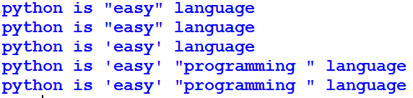
#Some example to write string using escape character.
A = "python is \"easy\" language "
B = 'python is "easy" language'
C = "python is 'easy' language "
D = '''python is 'easy' "programming " language '''
E = """python is 'easy' "programming " language """
print(A)
print(B)
print(C)
print(D)
print(E)
OUTPUT:

Slide 39
Python Variables:
A variable is a location in memory used to store some data(value).
The rules for writing a variable name is same as the rules for writing identifiers in Python.
We don't need to declare a variable before using it.
In Python, we simply assign a value to a variable and it will exist.
We don't even have to declare the type of the variable.
This is handled internally according to the type of value we assign to the variable.
Creating Variables syntax:
Syntax : Variable_name= value
Multiple Assignments Variables:
a,b,c,d,e,f=10,20,30,40,50,60
Example:
a = 5
b = 3.2
c = "Hello“
Note: Every Variable in Python is a Object

Slide 40
Data types
A Data Type describes the characteristic of a variable.
Every value in Python has a data type. Since everything is an object in Python programming, data types are actually classes and variables are instance (object) of these classes.
There are various data types in Python.
The python data types are divided into 2 main types:
1. Fundamental data types
2. Other Data types
A mutable object is an object whose state can be modified after it is created. An immutable object is an object whose state cannot be modified after it is created.

Slide 41
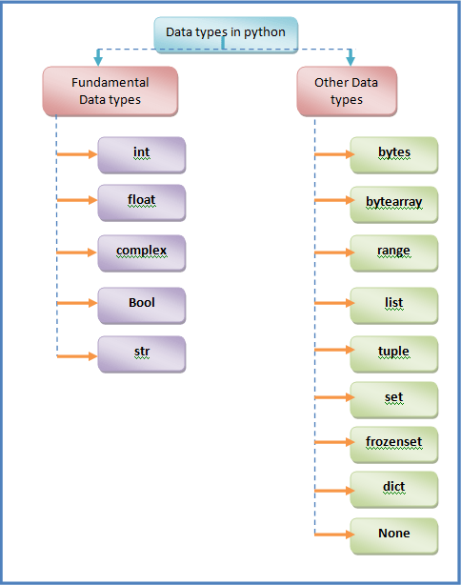

Slide 42
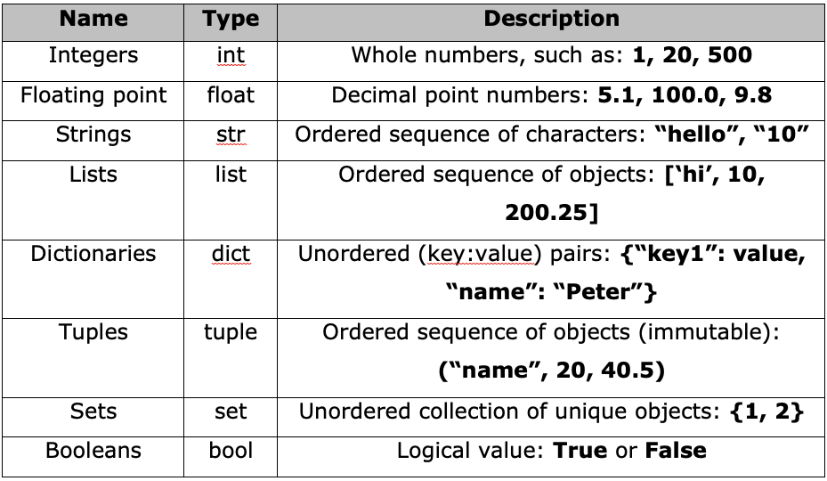

Slide 43
1 | int | To represent whole number.
2 | float | To represent value with decimal point
3 | complex | To store complex values. (complex number: a+bj)
4 | bool | To represent logical values we use bool like True/False
5 | str | Collection of any sequence of character
6 | bytes | To store group of byte number like array. It is immutable
7 | bytearray | To store group of values like array. it is mutable
8 | range | Range data type represents sequence of values.
9 | list | To represent group of values where insertion order is preserved and duplicates are allowed and it is mutable . []
10 | tuple | To represent group of values where insertion order is preserved and duplicates are allowed and it is immutable. ()
11 | set | A groups of values as a single entity where insertion order not preserved and duplicate values are not allowed and it is mutable. {}
12 | frozenset | A groups of values as a single entity where insertion order not preserved and duplicate values are not allowed and it is immutable
13 | dict | Dictionary is used to represent object as key and value pair Dict data type is used. {}
14 | None | None means nothing.

Slide 44
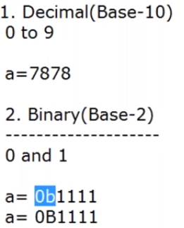
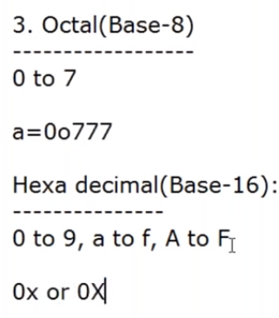
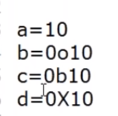
Note: The result only displays in decimal format
integral value, we represent value in 4 forms::
Decimal form:
Binary form
Octal form
Hexa form

Slide 45
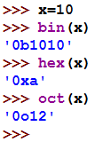
Base Conversions:
bin()
oct()
hexa()
Examples:

Slide 46
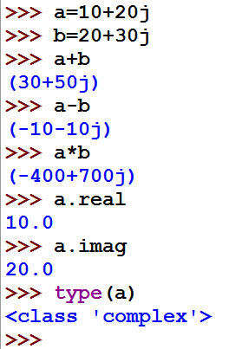
Complex data type examples:

Slide 47
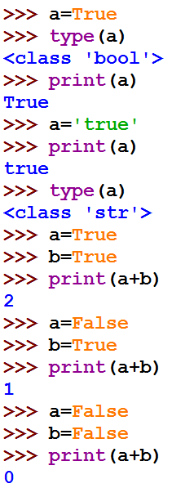
bool data type examples:

Slide 48
Python provides some inbuilt functions :
1. print(): print the statement
ex: print(“hello”)
2. type( ):
It is used to identity the type of the object
Ex: a=10
print(“Type of a:”,type(a))
b=“Hello”
print(“Type of b:”, type(b))
c=[ ]
print(“Type of c:”,type(c))
Output: Type of a:<class ‘int'>
Type of b:<class ‘str’>
Type of c:<class ‘list’>

Slide 49
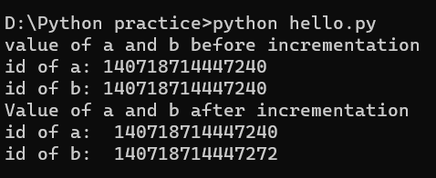
3. id (object):
It returns identity of an object.
It is the address of object in memory
It will be unique and constant throughout the lifetime of an object
Ex: a=20
b=a
print (“value of a and b before incrementation”)
print(“id of a:”,id(a))
print(“id of b:”,id(b))
b=a+1
print(“Value of a and b after incrementation”)
print("id of a: " , id(a))
print(“id of b: “ , id(b))

Slide 50
Operators:
Operator is a symbol which is responsible to perform a specific operation.
The value that the operator operates on is called the operand.
Operators are used to perform specific operations on one more operands(variables) and provides a result
Arithmetic operators
Relational Operators
Logical Operators
Assignment Operators
Bitwise Operators
Membership Operators
Identity Operators

Slide 51
Arithmetic operators:
Arithmetic operators are used to perform mathematical operations like addition, subtraction, multiplication etc.
Arithmetic operators in python
Operator | Meaning | Example
+ | Add two operands or unary plus | x + y +2
- | Subtract right operand from the left or unary minus | x - y -2
* | Multiply two operands | x * y
/ | Divide left operand by the right one (always results into float) | x / y
% | Modulus – remainder of the division of left operand by the right | x% y (remainder of x / y)
// | Floor division – division that result into whole number adjusted to the left in the number line | x // y
** | Exponent –left operand raised to the power of right | x ** y (x to the power of y)

Slide 52
Ex: x=15 Output
Y=4 x+y=19
Print(‘x+y=’,x+y) x-y=11
Print(‘x-y=’,x-y) x*y=60
Print(‘x*y=’,x*y) x/y=3.75
Print(‘x/y=’x/y) x//y=3
Print(‘x//y=’,x//y) x**y=50625
Print(‘x**y=’,x**y)

Slide 53
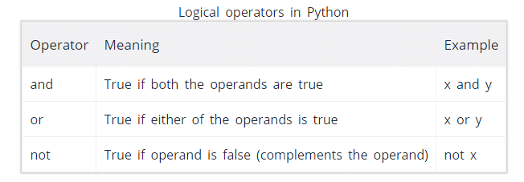
Logical operators:
Logical operators are the and, or, not operators. Based on Boolean Algebra returns results as either True or False

Slide 54
Eg x=True Output
Y=False x and y is false
Print(‘x and y is’,x and y) x or y is true
Print(‘x or y is’,x or y) not x is false
Print(‘not x is ‘,not x)

Slide 55
Assignment operators:
Assignment operators are used in Python to assign values to variables. a = 5 is a simple assignment operator that assigns the value 5 on the right to the variable a on the left.
Multiple Assignments: Same value can be assigned to more than one variable

Slide 56
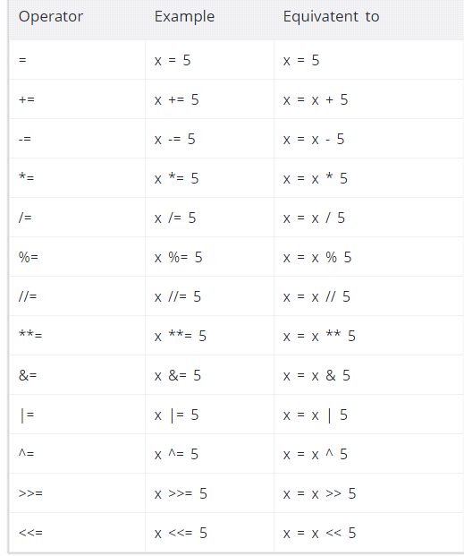

Slide 57
Bitwise operators :
Bitwise operators converts the operands data in the form of binary format performs operations on the binary values and gives the result in the form of decimal format.
Operator Meaning
& bitwise AND
| Bitwise OR
~ Bitwise NOT
^ Bitwise XOR
>> Bitwise right shift
<< Bitwise left shift

Slide 58
Ex: x=10 Output
Y=4 0
print(x&y) 4
print(x|y) -11
print(x~y) 14
print(x^y) 2
print(x>>y) 40
print(x<<y)

Slide 59
Special operators:
Python language offers some special type of operators like 1.membership operator.
2. identity operators
Membership operators:
in and not in are the membership operators in Python.
They are used to test whether a value or variable is found in a sequence(string, list, tuple, set and dictionary).
Operator | Description | Example
in | Returns to true if it finds a variable in given sequence else false | 5 in x
not in | Returns to true if it does not find a variable in given sequence else false | 5 not in x

Slide 60
Examples of ‘in’, ‘not in’
x = ["apple", "banana"]
print(“apple“ in x)
# returns True because “apple" is in the list
X=‘Hello’
print(‘H’ in X) returns true
print(x in X) returns false
print(X in X) returns true
x = ["apple", "banana"]
print("pineapple" not in x)
# returns True because "pineapple" is not in the list

Slide 61
Identity Operators:
is and is not are the identity operators in Python.
They are used to check if two values(or variables) are located on the same part of the memory. [used to compare memory locations of 2 objects]
Two variables that are equal does not imply that they are identical.
Ex:
Operator | Description | Example
is | Returns true if variable on either side of operator are referring to same object else false | x is y
is not | Returns true if both variables are not the same object. | x is not y

Slide 62
Examples of ‘is’, ‘is not’:
x = [‘Mango’, ‘Tree’]
y = [‘Mango’, ‘Tree’]
z = x
print(x is z)
# returns True because z is the same object as x
print(x is y)
# returns False because x is not the same object as y, even if they have the same content
print(x == y)
# to demonstrate the difference betweeen "is" and "==": this comparison returns True because x is equal to y
x = [‘Mango’, ‘Tree’]
y = [‘Mango’, ‘Tree’]
z = x
print(x is not z)
# returns False because z is the same object as x
print(x is not y)
# returns True because x is not the same object as y, even if they have the same content
print(x != y)
# to demonstrate the difference betweeen "is not" and "!=": this comparison returns False because x is equal to y

Slide 63
Casting in python is done using constructor functions:
int() - constructs an integer number from an integer literal, a float literal or a string literal
float() - constructs a float number from an integer literal, a float literal or a string literal
str() - constructs a string from a wide variety of data types, including strings, integer literals and float literals
Integers:
x = int(1) # x will be 1
y = int(2.8) # y will be 2
z = int("3") # z will be 3
Strings:
x = str("s1") # x will be 's1'
y = str(2) # y will be '2'
z = str(3.0) # z will be '3.0'
Floats:
x = float(1) # x will be 1.0
y = float(2.8) # y will be 2.8
z = float("3") # z will be 3.0
w = float("4.2") # w will be 4.2

Slide 64
Python Operators Precedence :
The following table lists all operators from highest precedence to lowest.
Operator Description
** Exponentiation (raise to the power)
~ + - Complement, unary plus and minus
*/ % // Multiply, divide, modulo and floor division
+ - Addition and subtraction
>> << Right and left bitwise shift
& Bitwise 'AND'
^ | Bitwise exclusive `OR' and regular `OR'
<= < > >= Comparison operators
<> == != Equality operators
= %= /= //= -= += *= **= Assignment operators
is, is not Identity operators
in, not in Membership operators
not, or, and Logical operators

Slide 65
Conditional Statements (if ,if- else ,Nested if-else):
Generally Python Program execution starts from the first line, executes each and every statement only once and stops the execution of the program when control reached to the last line.
These Statements are used to disturb the normal flow of execution of the program.
Block:
The set of statements which are following some space indentation is known as a Block.
Block begins when the indentation increases.
Blocks can contain other Blocks.
Blocks end when the indentation decreases to zero or to a containing blocks indentation.

Slide 66
Python supports 3 types of conditional statements. They are
If
else
elif
1. if:
Condition returns true then it executes the if block otherwise if block execution is skipped.
Syntax: if condition: statement (one statement)
Or
if condition :
Statement 1
Statement 2 (multiple statements)
--------------

Slide 67
EX:
print (“begin”)
x = input (“enter a positive number”)
i= int(x)
if i<10:
print (“given number is 1 digit number”)
print (“end”)
Output 1: begin Output2: begin
enter a positive number5 enter a positive number120 Given number is 1 digit number end
end

Slide 68
2. else:
else block should be preceded by any one of the following blocks.
1.if 2.elif 3.while 4.for
else block preceding block condition returns false then only it will execute the following else block.
Syntax:
if condition:
statement1
statement2
--------------
else:
statement1
statement2
--------------

Slide 69
Ex: print (“begin”)
x=input (“enter a positive number ”)
i = int(x)
if x<10:
print (“Given number is 1 digit number”)
else:
print (“Given number is >=2 digit number”)
print (“end”)
output 1: output 2:
enter a positive number 5 enter a positive number 52
Given number is 1 digit number Given number is >=2 digit number
end end

Slide 70
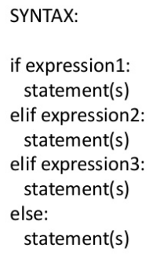
3.elif:
elif block should be preceded by either if block or another elif block.
elif block preceding block returns false then only control will go to the elif block.
After reaching the control block to the elif block, if condition returns true then only it will execute elif block.

Slide 71
Ex: print (“begin”)
x = input(“enter a positive number”)
i = int(x)
if i<10:
print (“given number is 1 digit number”)
elif i<100:
print (“given number is 2 digit number”)
elif i<1000:
print (“given number is 3 digit number”)
else :
print(“given number is >=4 digit number”)
print (“end”)
Output1: Output2:
begin begin
enter a positive number5 enter a positive number15
given number is 1 digit number given number is 2 digit number
end end

Slide 72
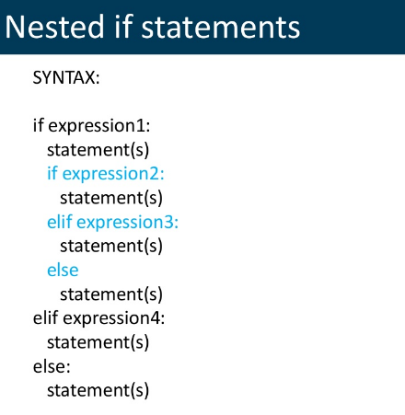

Slide 73

Looping( for, while nested loops)
While:
In python, while loop is used to execute a block of statements repeatedly until a given a condition is satisfied.
when the condition becomes false, the line immediately after the loop in program is executed.
Example:
i=1
sum =0
while i<=100:
sum = sum+i
i = i+1
print ("sum is : "+str(sum))

Slide 74
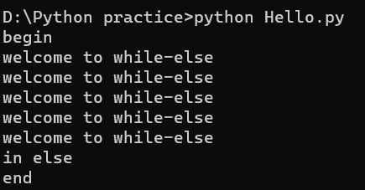
Ex: Program for using while-else
print ("begin")
i =1
while i<=5: print ("welcome to while-else ") i = i + 1
else:
print ("in else")
print ("end")

Slide 75
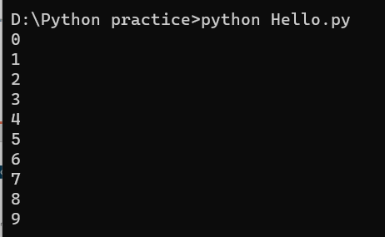
For loop:
for loop executes the given logic with respect to every element of the iterable object
Syntax: for variable name in iterable object:
---------------------------
---------------------------
Ex
numbers = [0, 1, 2, 3, 4, 5, 6, 7, 8, 9]
for x in numbers:
print (x)

Slide 76
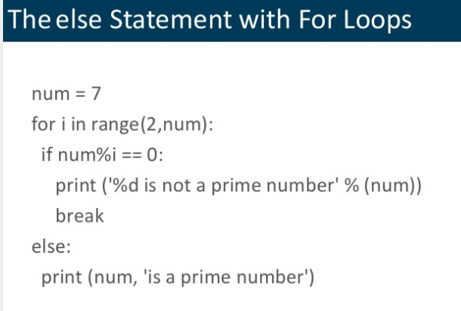

Slide 77
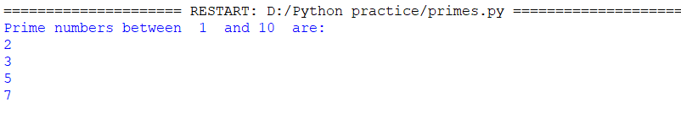
# Program to generate prime numbers in a given range
num1=1
num2=10
print('Prime numbers between ',num1,' and',num2,' are:')
for num in range(num1,num2+1):
if num>1:
for i in range(2,num):
if (num%i)==0:
break
else:
print(num)

Slide 78
Control Statements(break , continue ,pass)
break :
To interrupt the loop, to start a new iteration (one “round” of executing the block), or to simply end the loop we use break.
EX:
print (“begin”)
i =1
while True:
print (“welcome”)
i =i+1
if i==5:
break
else:
print (“if else”)
print (“end”)

Slide 79
Continue:
It causes the current iteration to end, and to “jump” to the beginning of the next.
It basically means “skip the rest of the loop body, but don’t end the loop.”
EX
while True:
name = input("enter user name:")
if name!=‘Vidya':
continue
password = input("Hello Vidya, enter password")
if password==‘Vidya':
print("access granted")
break

Slide 80
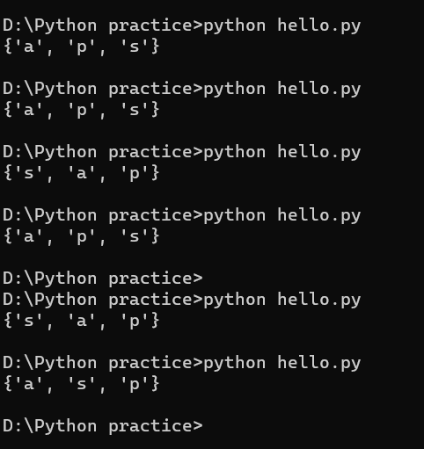
Pass:
A pass statement signals to a loop that there is “no code to execute here.”
In Python programming, pass is a null statement.
The difference between a comment and pass statement in Python is that, while the interpreter ignores a comment entirely, pass is not ignored.
However, nothing happens when pass is executed. It results into no operation (NOP).
Ex:
1)sequence = {'p', 'a', 's', 's'}
for val in sequence:
pass
print(sequence)
2)a=12
if(a<10):
pass
else:
print("hello")

Slide 81
Printing on Screen ----Python print() Function
The print() function prints the specified message to the screen, or other standard output device.
The message can be a string, or any other object, the object will be converted into a string before written to the screen
Syntax
print(object(s), sep=separator, end=end, file=file, flush=flush)
Parameter Values
Parameter | Description
object(s) | Any object, and as many as you like. Will be converted to string before printed
sep='separator' | Optional. Specify how to separate the objects, if there is more than one. Default is ' '
end='end' | Optional. Specify what to print at the end. Default is '\n' (line feed)
file | Optional. An object with a write method. Default is sys.stdout
flush | Optional. A Boolean, specifying if the output is flushed (True) or buffered (False). Default is False

Slide 82
Examples
Print more than one object:
print("Hello", "how are you?")
Output
Hello how are you?
Print two messages, and specify the separator:
print("Hello", "how are you?", sep="---")
Output
Hello---how are you?
Print a tuple:
x = ("apple", "banana", "cherry")
print(x)
Output
('apple', 'banana', 'Cherry')
Print a List:
x=["apple","banana","Cherry"]
print(x)
Output
['apple', 'banana', 'Cherry']
print(type(x))
Output
<class 'list'>

Slide 83
#\n provides new line after printing the year
print('09','10','2024', sep='-', end='\n')
print('Red','Green','Blue', sep=',', end='@')
print(‘IT C Section')
print('hi','Sreevi',sep='@',end='#\n')
print('Hi','Sreevi',sep='@',end='')
print('dya#')
Output
09-10-2024
Red,Green,Blue@IT C Section
Hi@Sreevi#
Hi@Sreevidya#

Slide 84
Reading data from keyboard
Python allows for user input. That means we are able to ask the user for input.
Python 3.6 uses the input() method.
Python 2.7 uses the raw_input() method.
Python 3.6
username = input("Enter username: ")
print("Username is: " + username)
Enter username: Sree
Username is: Sree
Python 2.7
username = raw_input("Enter username:")
print("Username is: " + username)
Enter username: Sree
Username is: Sree

Slide 85
Opening and closing file
Python provides basic functions and methods necessary to manipulate files by default.
The open Function
Before you can read or write a file, you have to open it using Python's built-in open() function. This function creates a file object, which would be utilized to call other support methods associated with it.
Syntax
file object = open(file_name [, access_mode][, buffering])
Parameter details
file_name − name of the file
access_mode − read, write, append, etc, default file access mode is read (r).
buffering − 0--> no buffering
1-->line buffering
>1--> buffering action is performed with the indicated buffer size
negative→the buffer size is the system default(default behavior).

Slide 86
access_mode − The access_mode can be r,r+,rb,rb+,w,w+,wb,wb+,a,a+,ab,ab+
b indicates in binary format
r-read only
r+ - read and write
rb – read in binary format
rb+ - read and write in binary format
w- write only
w+ - writing and reading
wb-writing in binary format
wb+ -writing and reading in binary format
a – append
a+ - append and reading
ab – append in binary format
ab+ - append and read in binary format
list of all attributes related to file object −
Sr.No | Modes & Description
1 | file.closed Returns true if file is closed, false otherwise.
2 | file.mode Returns access mode with which file was opened.
3 | file.name Returns name of the file.
4 | file.softspace Returns false if space explicitly required with print, true otherwise.

Slide 87
Example
# Open a file
fo = open("foo.txt", "wb")
print "Name of the file: ", fo.name
print "Closed or not : ", fo.closed
print "Opening mode : ", fo.mode
print "Softspace flag : ", fo.softspace
The close() Method
The close() method of a file object flushes any unwritten information and closes the file object, after which no more writing can be done.
Python automatically closes a file when the reference object of a file is reassigned to another file.
Output
Name of the file: foo.txt
Closed or not : False
Opening mode : wb
Softspace flag : 0
Syntax
fileObject.close()
Example
# Open a file
fo = open("foo.txt", "wb")
print "Name of the file: ", fo.name
# Close opened file
fo.close()
Output
Name of the file: foo.txt

Slide 88
